Slide 1
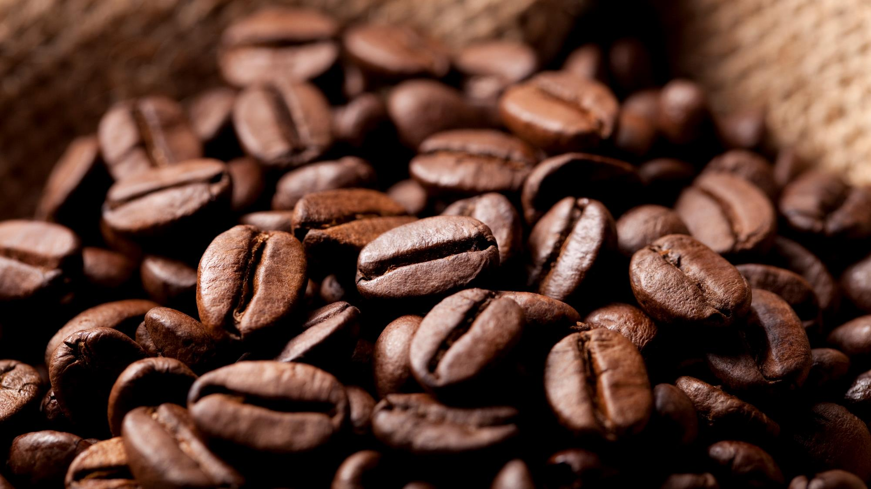
Bright coffee shop
SALES ANALYSIS BY: Gomolemo Moabalobelo

Slide 2
ConTENT
Introduction 3
Analysis breakdown 4-9
Sales per Time of Day 4
Sales per Month 5
Sales: Weekdays VS Weekends 6
Revenue per Store 7
Sales per store location 8
Sales per Product 9
Conclusion 10

Slide 3
Introduction
This project analyzes transactional sales data from Bright Coffee Shop to help the newly appointed CEO increase revenue and improve product performance. As a Junior Data Analyst, I used SQL, data analytics, and visualization tools to turn raw data into actionable business insights.
The analysis focuses on identifying:
1. The top revenue-generating products
2. The best-performing times of the day
3. Sales trends across products and time periods
4. Recommendations to enhance overall sales performance

Slide 4
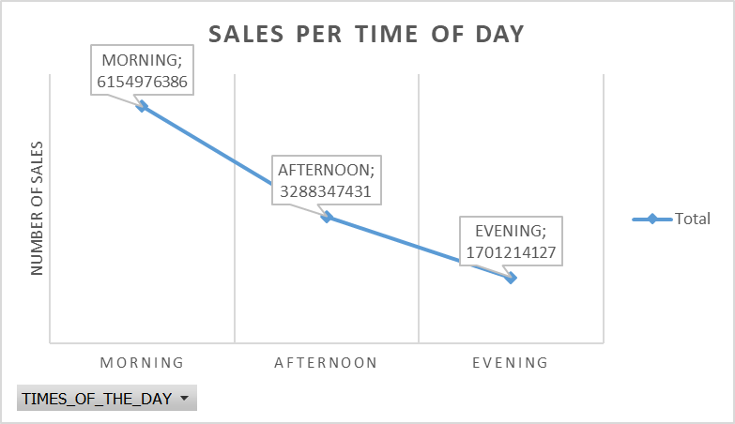
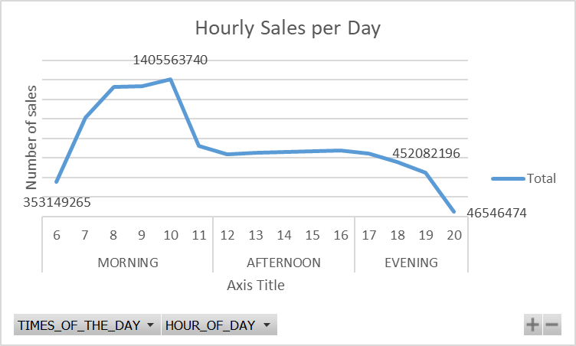
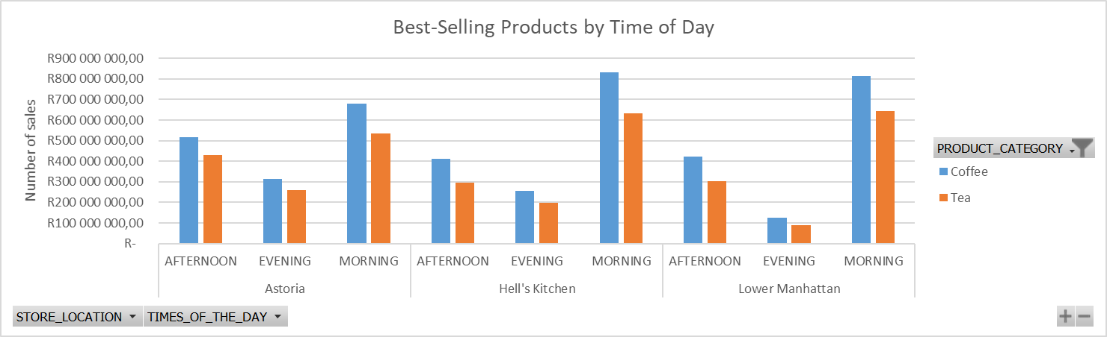
SALES PER TIME OF DAY
Morning sales peak at 6.15 billion, especially between 8 AM and 10 AM, before dropping 46.6% in the afternoon and 72.4% by evening. Afternoon sales remain steady but lower, while evening sales are minimal. Coffee and tea are the two top-performing products, with coffee consistently outselling tea across all locations, particularly in Hell’s Kitchen (31.58% higher), highlighting a strong preference for coffee.
Recommendations: Focus on boosting morning sales with targeted promotions, maintain afternoon sales through combo deals, and implement strategies to increase evening sales.

Slide 5
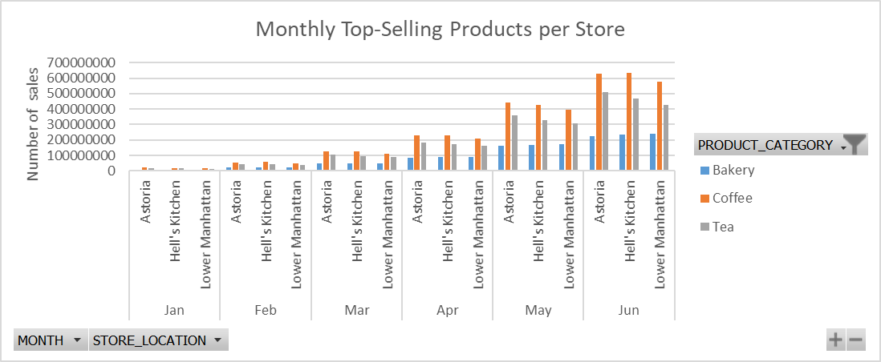
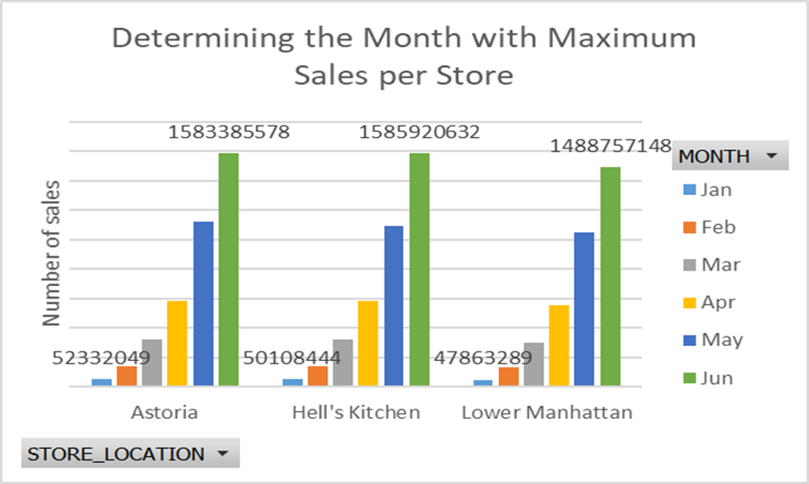
SALES PER month
Coffee consistently sells more than bakery and tea, while bakery is the lowest-performing product each month. June sales are much higher than January in all locations—Astoria (96.70%), Hell’s Kitchen (96.83%), and Lower Manhattan (96.78%),showing a clear mid-year peak. This indicates that coffee drives most revenue, with potential to improve bakery sales during slower months.
Recommendations: Focus on promoting coffee during peak months to maximize revenue, while introducing marketing or discounts to boost bakery sales in slower months.

Slide 6
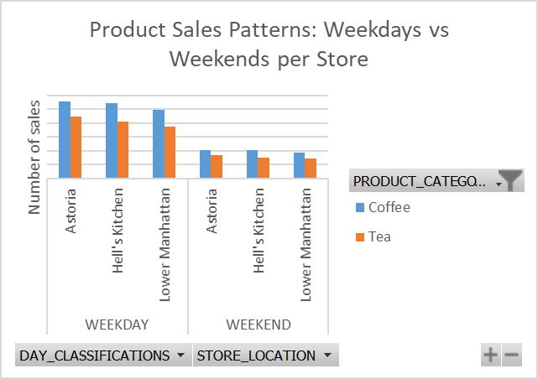
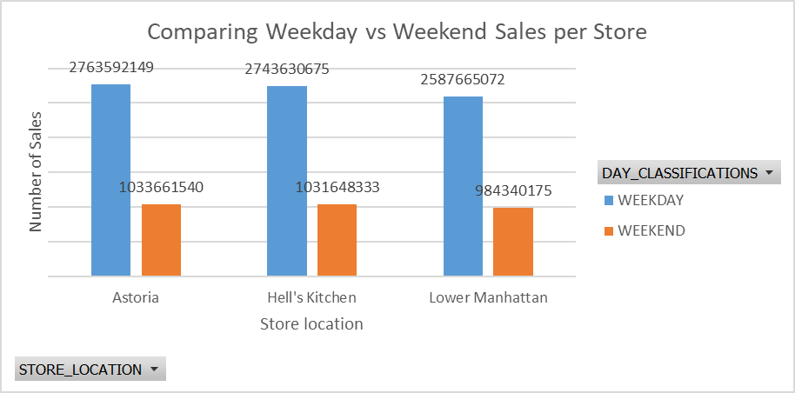
SALES: weekdays vs weekends
Coffee consistently outsells tea across all locations, with the largest margins at Hell’s Kitchen and Lower Manhattan. Weekday sales are significantly higher than weekends, with weekend sales dropping around 62% in all locations. This shows that weekdays drive most revenue, while coffee remains the top-selling product throughout the week.
Recommendations: Consider launching seasonal or limited-time coffee promotions during weekends to attract more customers and reduce the weekday-weekend sales gap.

Slide 7
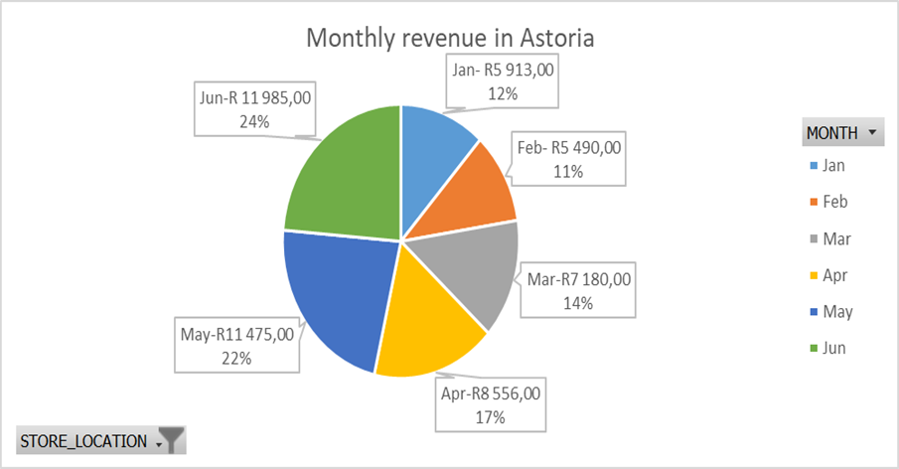
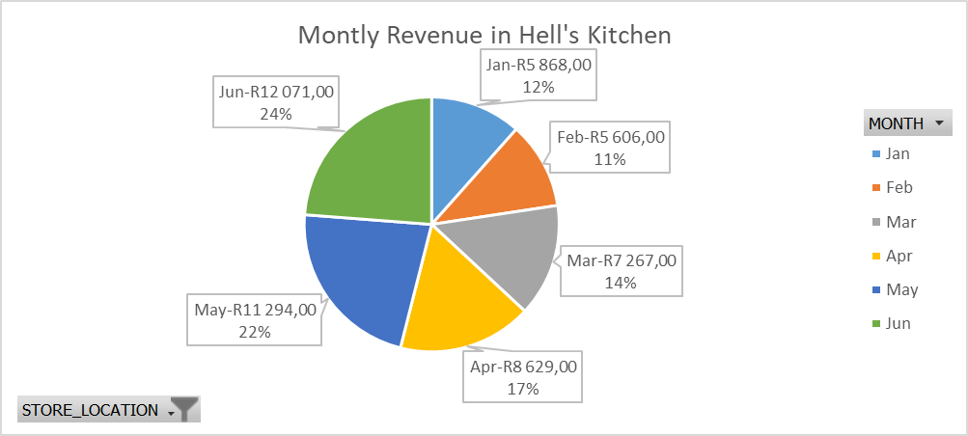
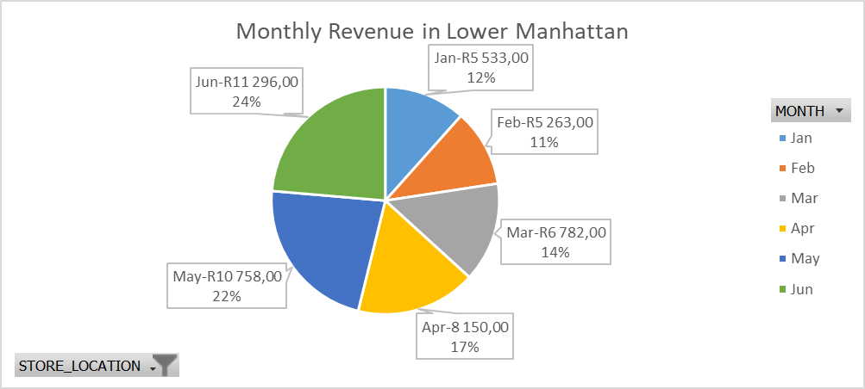
Revenue Per store
Across all locations, June is the highest revenue month, while February is the lowest. Astoria’s revenue rose from 5,490 in February to 11,985 in June (54.6% increase), Hell’s Kitchen from 5,606 to 12,071 (46.41% increase), and Lower Manhattan from 5,263 to 11,296 (46.56% increase). This shows a strong mid-year peak, with opportunities to boost sales during slower months like February.
Recommendations: Implement targeted promotions or discounts during slower months like February to increase customer engagement and overall revenue.

Slide 8
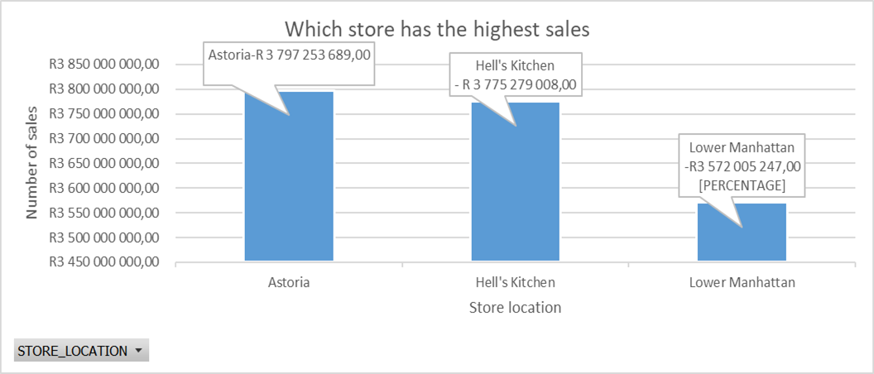
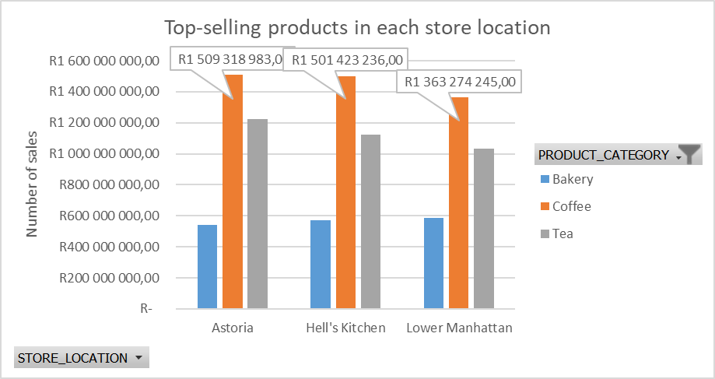
Sales per store location
Astoria leads in total sales, exceeding Hell’s Kitchen by R71,974,681 (1.93%) and Lower Manhattan by R225,248,442 (6.31%). Coffee is the top-selling product at all locations, accounting for 46.10% of sales at Astoria, 46.95% at Hell’s Kitchen, and 45.66% at Lower Manhattan. Astoria drives the highest revenue.
Recommendations: targeted promotions could help boost sales at the other locations.

Slide 9
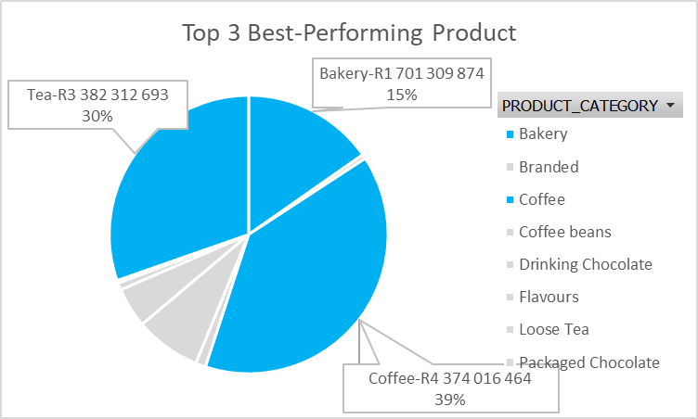
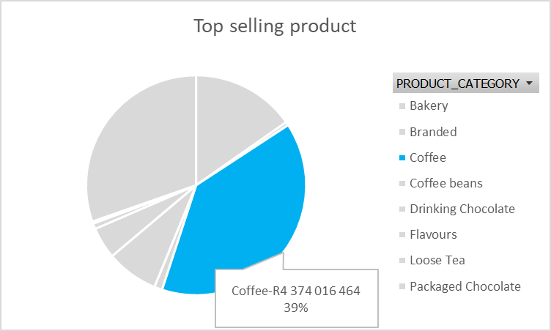
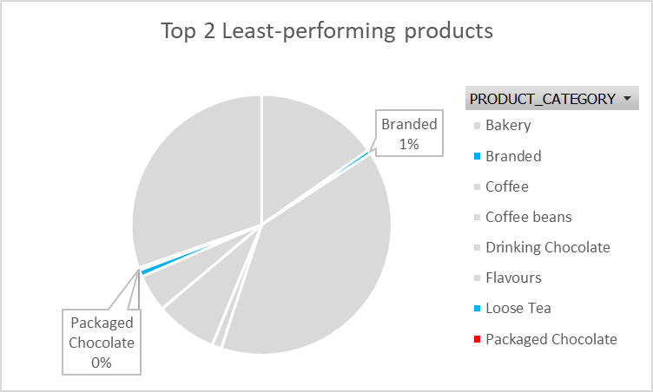
Sales per product
Coffee is the top-selling product at 39% of total sales, followed by tea (30%) and bakery (15%). Branded products (1%) and packaged chocolate (0%) perform the lowest.
Recommendations: Focus should be on promoting and managing inventory for coffee, tea, and bakery, while reconsidering strategies for low-performing items.

Slide 10
Conclusion
The data indicates that June is the peak revenue month across all stores, with weekdays accounting for the majority of sales. Early-year months, especially January and February, generate significantly lower revenue, revealing a clear seasonal sales pattern. Focusing on optimizing weekday performance and capitalizing on high-revenue months like June could further boost overall results, while stores such as Astoria and Hell’s Kitchen consistently outperform Lower Manhattan.

Slide 11


Thank You
Email gmoabalobelo@gmail.com

